Slide 1
DATA ANALYST INTERNSHIP Task 3 DASHBOARD DESIGN
Name : R. Rathna Mala
Department : Artificial Intelligence & Machine Learning
College : Manakula Vinayagar Institute of Technology
Tool Used : Microsoft Power BI
Date : 16 July 2026

Slide 2
OBJECTIVE:
Create an interactive dashboard.
Analyze sales performance.
Present business insights.

Slide 3
DASHBOARD FEATURES:
KPI Cards
Line Chart
Pie Chart
Bar Charts
Slicers

Slide 4
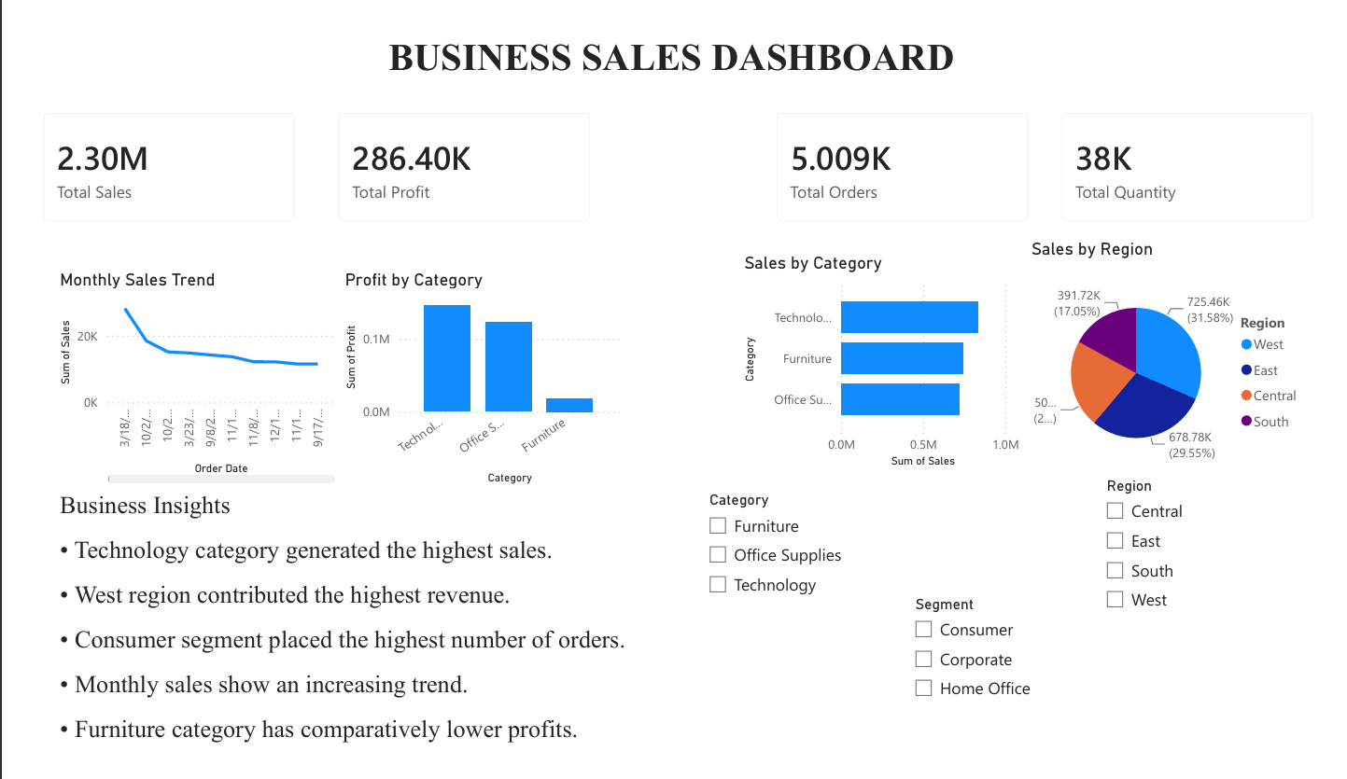
DASHBOARD SCREENSHOT:

Slide 5
BUSINESS INSIGHTS:
Technology category generated the highest sales.
West region contributed the highest revenue.
Consumer customers placed the highest number of orders.
Monthly sales show seasonal trends.
Furniture category has comparatively lower profitability.

Slide 6
CONCLUSION:
The interactive dashboard helps stakeholders monitor sales, profit, and regional performance, enabling informed business decisions.

